Slide 1


<Name>
<Date>

Slide 2

Outline
Executive Summary
Introduction
Methodology
Results
Conclusion
Appendix

Slide 3
Executive Summary
Summary of methodologies
Data Collection through API
Data Collection with Web Scraping
Data Wrangling
Exploratory Data Analysis (EDA) with SQL
Exploratory Data Analysis (EDA) with Data Visualization
Interactive Visual Analytics with Folium
Interactive Visual Analytics with Ploty Dashboard
Machine Learning Prediction
Summary of all results
Exploratory Data Analysis
Interactive Analytics
Predictive Analytics

Slide 4
Introduction
Project background and context
Space X advertises Falcon 9 rocket launches on its website with a cost of 62 million dollars; other providers cost upward of 165 million dollars each, much of the savings is because Space X can reuse the first stage. Therefore, if we can determine if the first stage will land, we can determine the cost of a launch. This information can be used if an alternate company wants to bid against space X for a rocket launch. This goal of the project is to create a machine learning pipeline to predict if the first stage will land successfully.
Problems you want to find answers
What factors determine if the rocket will land successfully?
The interaction amongst various features that determine the success rate of a successful landing.
What operating conditions needs to be in place to ensure a successful landing program

Slide 5

Section 1

Slide 6
Methodology
Executive Summary
Data collection methodology:
Data was collected using SpaceX API and web scraping from Wikipedia
Perform data wrangling
One-hot encoding was applied to categorical features
Perform exploratory data analysis (EDA) using visualization and SQL
Perform interactive visual analytics using Folium and Plotly Dash
Perform predictive analysis using classification models
Use of machine learning to build the models and use testing dataset to tune the models, and evaluate classification models with confusion matrix

Slide 7
Data Collection
Data collection phrases
Data collection was done using get request to the SpaceX REST API.
Decoded the response content as a JSON function call and turn it into a pandas dataframe
Cleaned the data, checked for missing values and fill in missing values where necessary.
Performed web scraping from Wikipedia for Falcon 9 launch records with BeautifulSoup.
Extract the launch records as HTML table, parse the table
Convert it to a pandas dataframe for future analysis

Slide 8
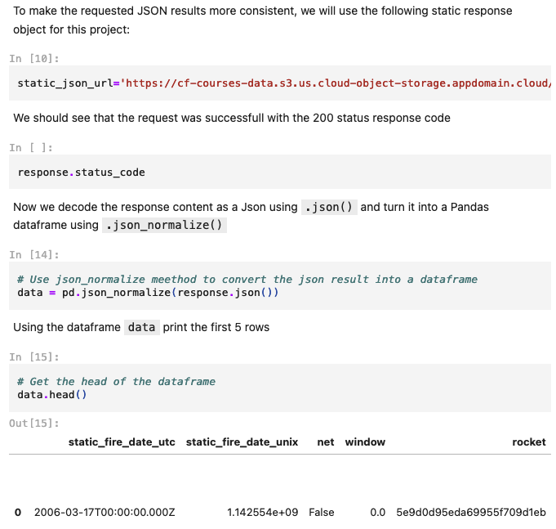
Data Collection – SpaceX API
Get request to the SpaceX API to collect data, clean the requested data and did some basic data wrangling and formatting
The link to the notebook: https://github.com/Khong2612/testrepo/blob/3c31c982183dab7e2eb444b80c2e3488b7b2116e/1-jupyter-labs-spacex-data-collection-api.ipynb
Place your flowchart of SpaceX API calls here

Slide 9
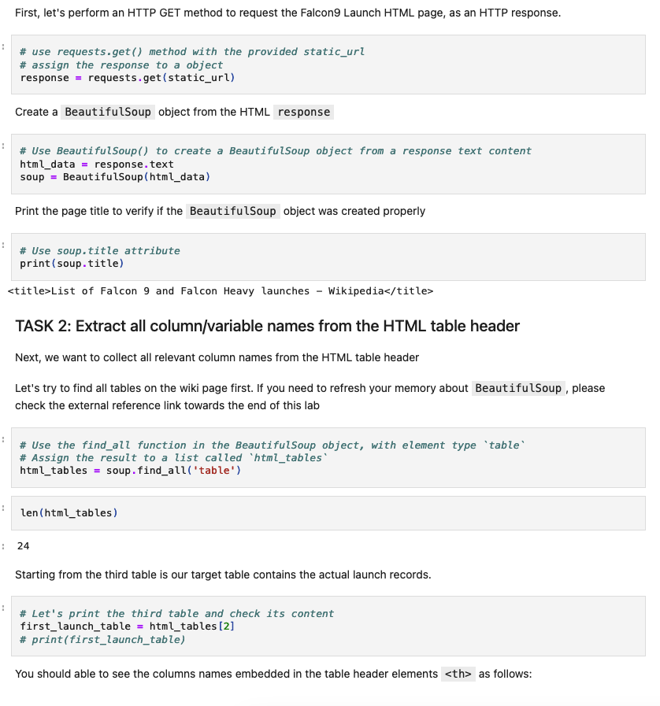
Data Collection - Scraping
Applied web scrapping to webscrap Falcon 9 launch records with BeautifulSoup
Parsed the table and converted it into a pandas dataframe.
The link to the notebook: https://github.com/Khong2612/testrepo/blob/3c31c982183dab7e2eb444b80c2e3488b7b2116e/2-jupyter-labs-webscraping.ipynb
Place your flowchart of web scraping here

Slide 10
Data Wrangling
Performed exploratory data analysis and determined the training labels.
Calculated the number of launches at each site, and the number and occurrence of each orbits
Created landing outcome label from outcome column and exported the results to csv.
The link to the notebook: https://github.com/Khong2612/testrepo/blob/3c31c982183dab7e2eb444b80c2e3488b7b2116e/3-jupyter-spacex-data-wrangling.ipynb

Slide 11
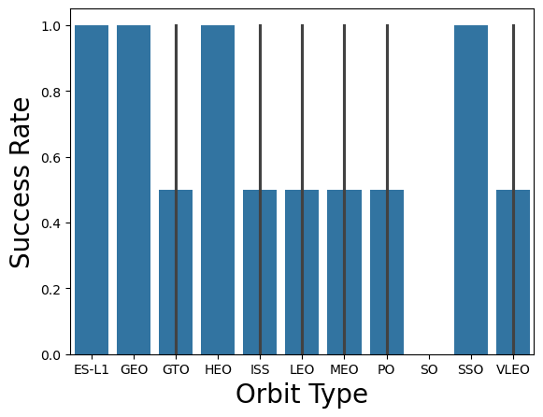
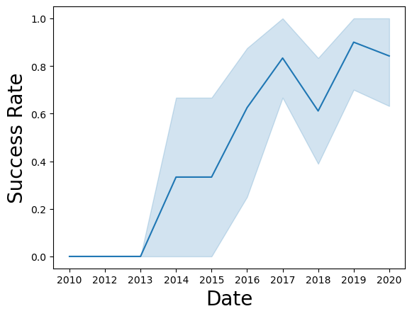
EDA with Data Visualization
Explored the data by visualizing the relationship between flight number and launch Site, payload and launch site, success rate of each orbit type, flight number and orbit type, the launch success yearly trend.
The link to the notebook: https://github.com/Khong2612/testrepo/blob/3c31c982183dab7e2eb444b80c2e3488b7b2116e/jupyter-labs-eda-dataviz.ipynb

Slide 12
EDA with SQL
Loaded the SpaceX dataset into a PostgreSQL database without leaving the jupyter notebook.
Applied EDA with SQL to get insight from the data. We wrote queries to find out for instance:
The names of unique launch sites in the space mission.
The total payload mass carried by boosters launched by NASA (CRS)
The average payload mass carried by booster version F9 v1.1
The total number of successful and failed mission outcomes
The failed landing outcomes in drone ship, their booster version and launch site names.
The link to the notebook https://github.com/Khong2612/testrepo/blob/3c31c982183dab7e2eb444b80c2e3488b7b2116e/jupyter-labs-eda-sql-coursera_sqllite.ipynb

Slide 13
Build an Interactive Map with Folium
Marked all launch sites, and added map objects such as markers, circles, and lines to mark the success or failure of launches for each site on the folium map.
Assigned the feature launch outcomes (failure or success) to class 0 and 1.i.e., 0 for failure, and 1 for success.
Using the color-labeled marker clusters, we identified which launch sites have relatively high success rates.
Calculated the distances between a launch site to its proximities. We answered some questions for instance:
Are launch sites near railways, highways and coastlines.
Do launch sites keep a certain distance away from cities.
The link to the notebook https://github.com/Khong2612/testrepo/blob/3c31c982183dab7e2eb444b80c2e3488b7b2116e/lab_jupyter_launch_site_location.ipynb

Slide 14
Build a Dashboard with Plotly Dash
Built an interactive dashboard with Plotly dash
Plotted pie charts showing the total launches by a certain sites
Plotted scatter graph showing the relationship with Outcome and Payload Mass (Kg) for the different booster version.
The link to the notebook https://github.com/Khong2612/testrepo/blob/444f7f3775dc75438678adff35971bbe30911d3e/spacex_dash_app.py

Slide 15
Predictive Analysis (Classification)
Loaded the data using numpy and pandas, transformed the data, split our data into training and testing.
Built different machine-learning models and tune d different hyperparameters using GridSearchCV.
Used accuracy as the metric for our model, improved the model using feature engineering and algorithm tuning.
Found the best-performing classification model.
The link to the notebook https://github.com/Khong2612/testrepo/blob/444f7f3775dc75438678adff35971bbe30911d3e/SpaceX_Machine_Learning_Prediction_Part_5.jupyterlite.ipynb

Slide 16
Results
Exploratory data analysis results
Interactive analytics demo in screenshots
Predictive analysis results

Slide 17

Section 2

Slide 18
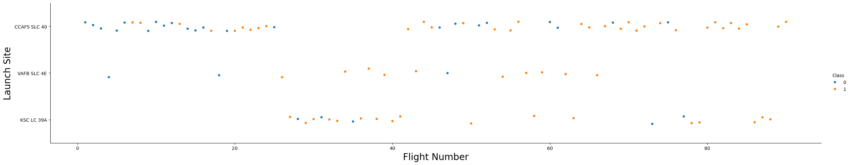
Flight Number vs. Launch Site
A scatter plot of Flight Number vs. Launch Site
The larger the flight amount at a launch site, the greater the success rate at a launch site.

Slide 19
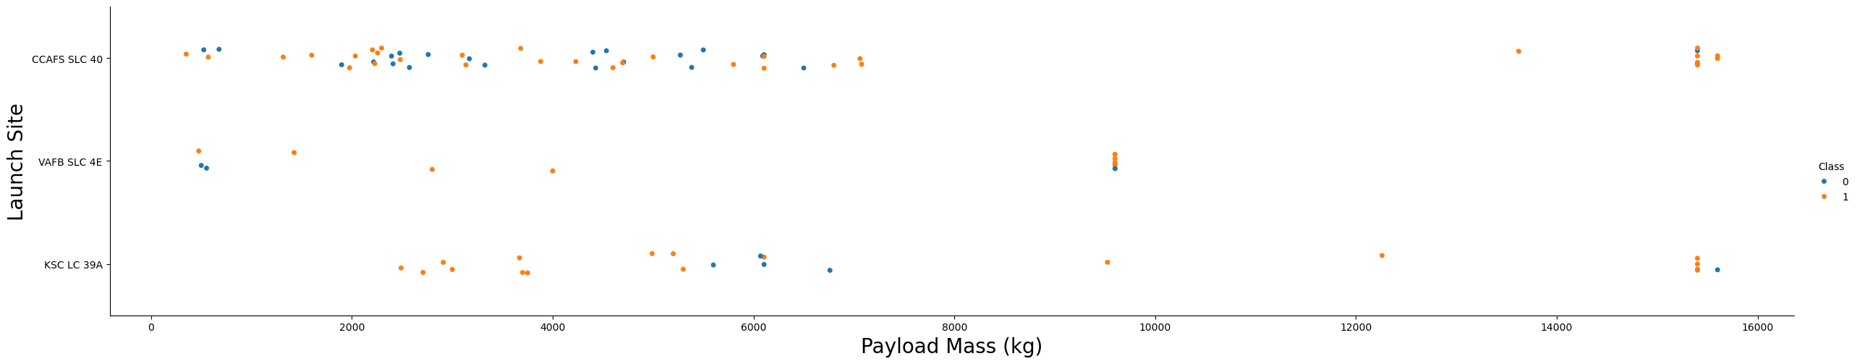
Payload vs. Launch Site
A scatter plot of Payload vs. Launch Site
The greater the payload mass for launch site CCAFS SLC 40 the higher the success rate for the rocket

Slide 20
Success Rate vs. Orbit Type
Abar chart for the success rate of each orbit type
ES-L1, GEO, HEO, SSO, VLEO had the most success rate.

Slide 21
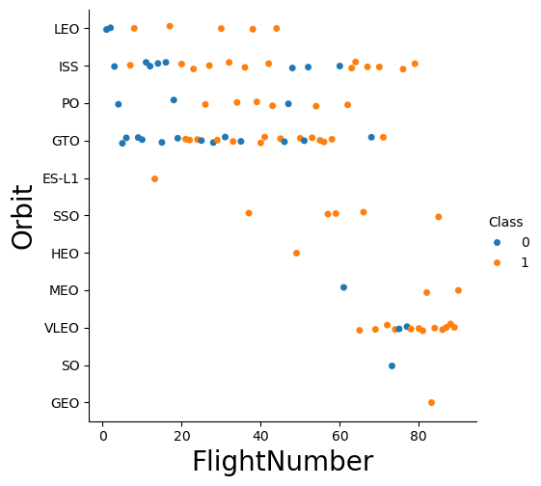
Flight Number vs. Orbit Type
A scatter point of Flight number vs. Orbit type
In the LEO orbit, success is related to the number of flights whereas in the GTO orbit, there is no relationship between flight number and the orbit.

Slide 22
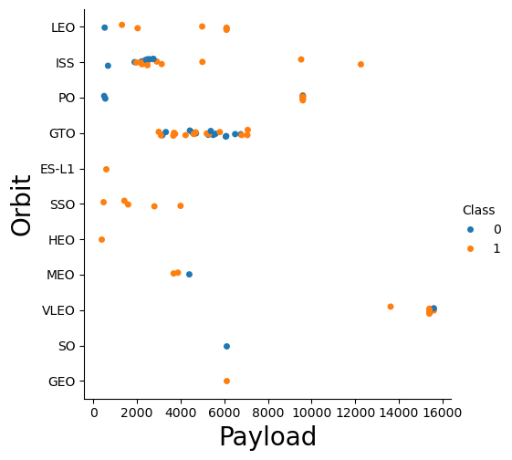
Payload vs. Orbit Type
A scatter point of payload vs. orbit type
Observed that with heavy payloads, the successful landing is more for PO, LEO and ISS orbits.

Slide 23
Launch Success Yearly Trend
A line chart of yearly average success rate
Observed that success rate since 2013 kept on increasing till 2020.

Slide 24
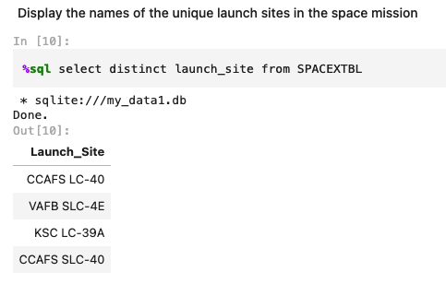
All Launch Site Names
The names of the unique launch sites
The Key word DISTINCT is used to show only unique launch sites from the SpaceXdata.

Slide 25
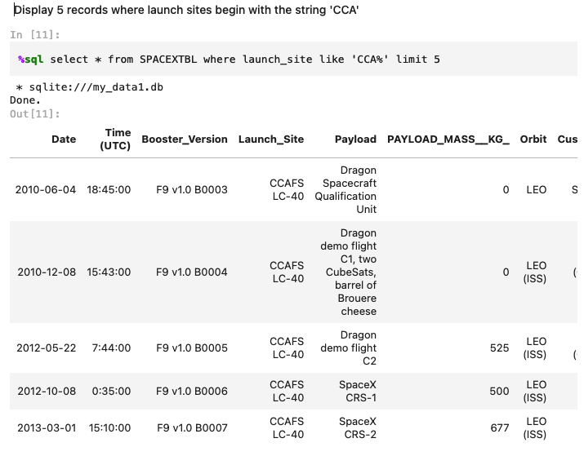
Launch Site Names Begin with 'CCA'
5 records where launch sites begin with `CCA`
Where clause and keyword like are used to subset the observations with the launch sites begin with ‘CCA’.
The keyword limit is used to control the number of output.

Slide 26
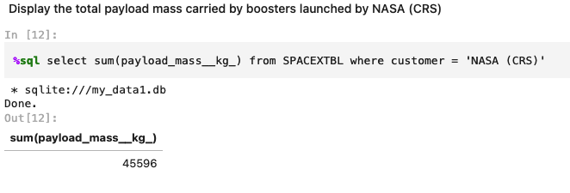
Total Payload Mass
The total payload carried by boosters from NASA is 45596.
SUM function is used to calculate the total payload carried.

Slide 27
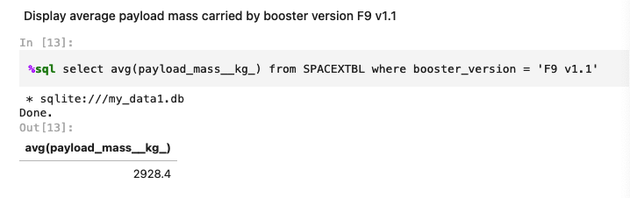
Average Payload Mass by F9 v1.1
The average payload mass carried by booster version F9 v1.1 is 2928.4
AVG function is used to calculate the average payload mass

Slide 28
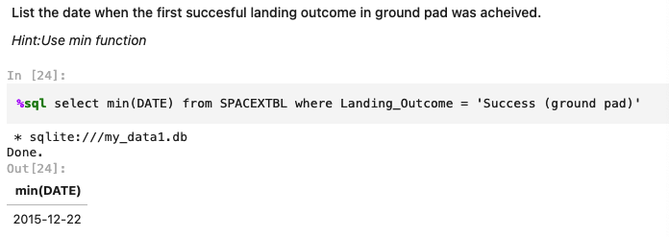
First Successful Ground Landing Date
The dates of the first successful landing outcome on ground pad is 2015-12-22
Min function is used to extract the dates of the first successful landing outcome from success (ground pad)

Slide 29
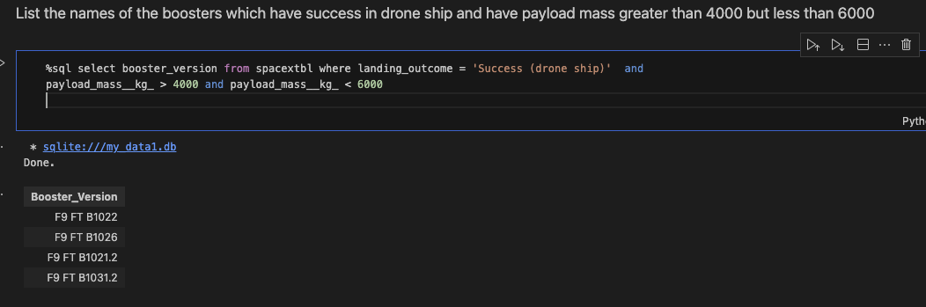
Successful Drone Ship Landing with Payload between 4000 and 6000
List the names of boosters which have successfully landed on drone ship and had payload mass greater than 4000 but less than 6000
Where clause and comparison operators are used.
Four boosters was extracted

Slide 30
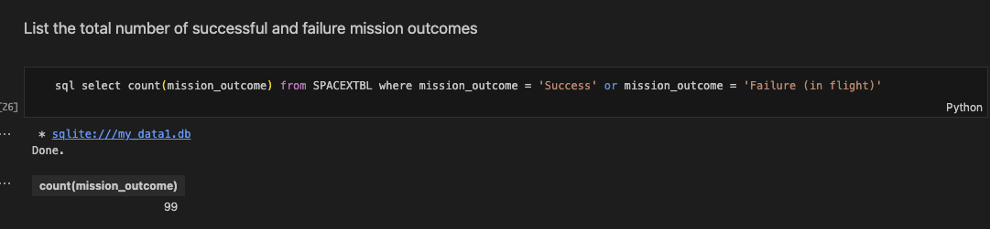
Total Number of Successful and Failure Mission Outcomes
The total number of successful and failure mission outcomes is 99
Count function is used

Slide 31
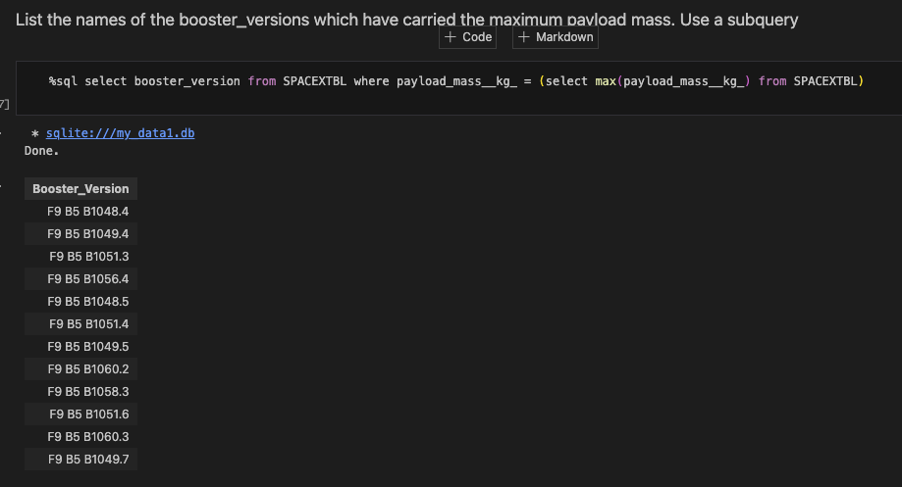
Boosters Carried Maximum Payload
List the names of the booster which have carried the maximum payload mass
Max function and subquery are used to generate the list

Slide 32
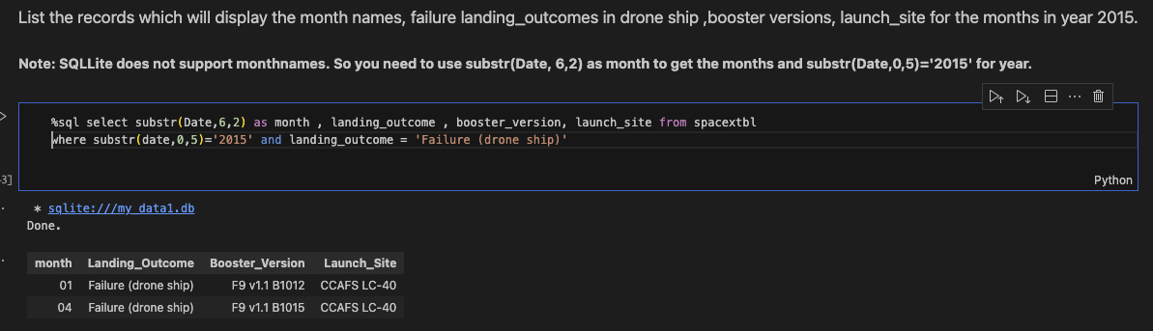
2015 Launch Records
List the failed landing_outcomes in drone ship, their booster versions and launch site names for in year 2015
Substr function are used to extract the month and from date.
Two sites was extracted

Slide 33
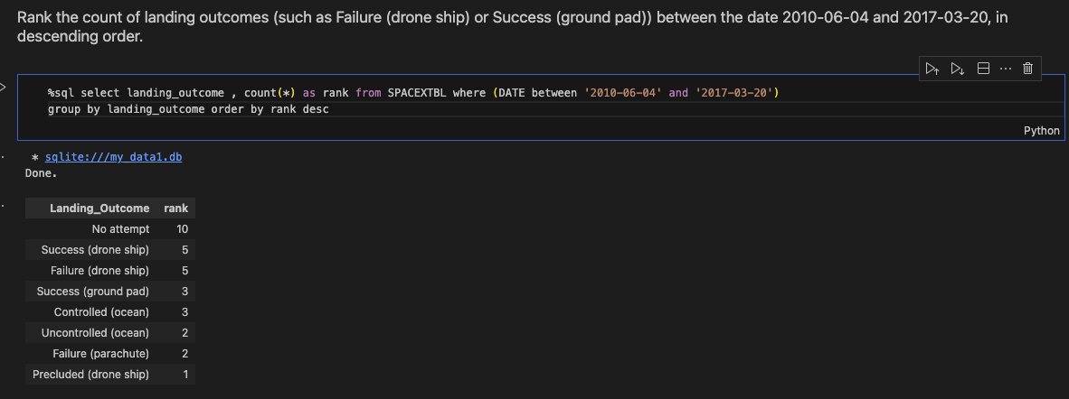
Rank Landing Outcomes Between 2010-06-04 and 2017-03-20
Rank the count of landing outcomes (such as Failure (drone ship) or Success (ground pad)) between the date 2010-06-04 and 2017-03-20, in descending order
Group by function is used to consolidate the landing_outcome data.
8 landing outcomes was ranked. The top one is NO Attempt

Slide 34

Section 3

Slide 35
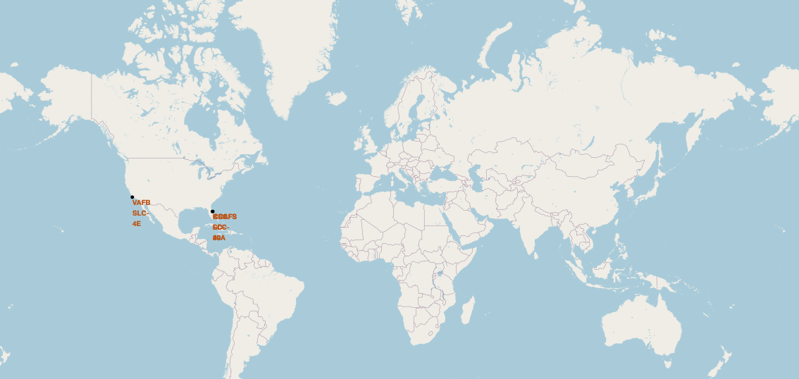
All launch sites global map markers
The SpaceX launch sites are in the US (Florida and California)

Slide 36
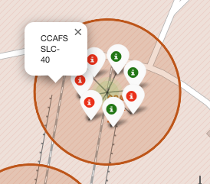
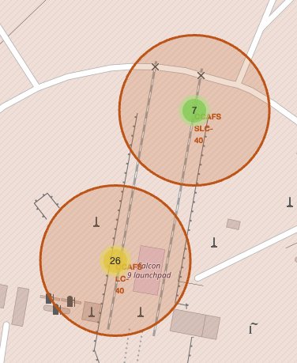
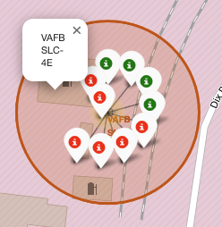
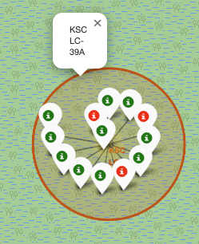
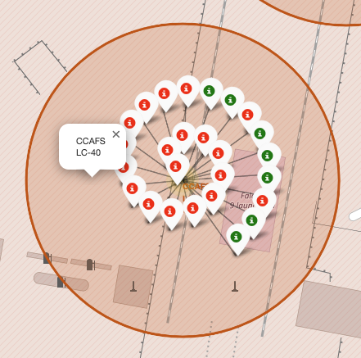
Markers showing launch sites with color labels
Florida Launch Sites
California Launch Sites
Green Marker shows successful launches
Red Marker shows the failure

Slide 37
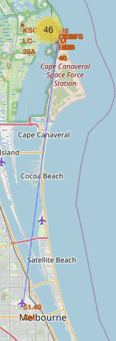
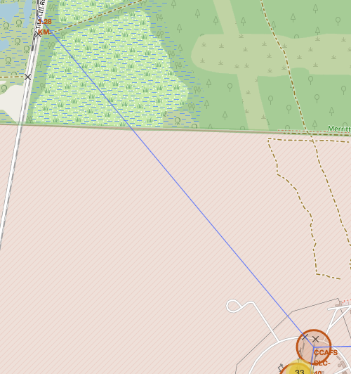
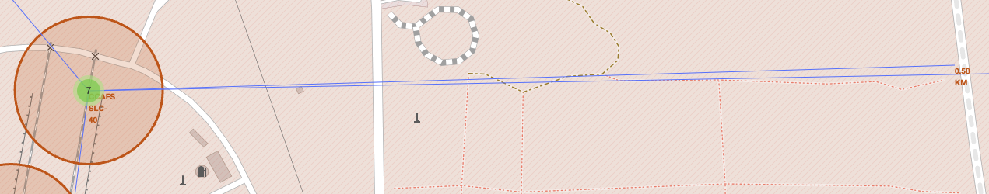
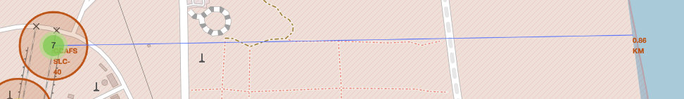
Launch Site distance to landmarks
Distance to City:
Distance to railway:
Distance to Highway:
Distance to coastline
Are launch sites in close proximity to railways? No
Are launch sites in close proximity to highways? Yes
Are launch sites in close proximity to coastline? Yes
- Do launch sites keep certain distance away from cities? Yes

Slide 38

Section 4

Slide 39
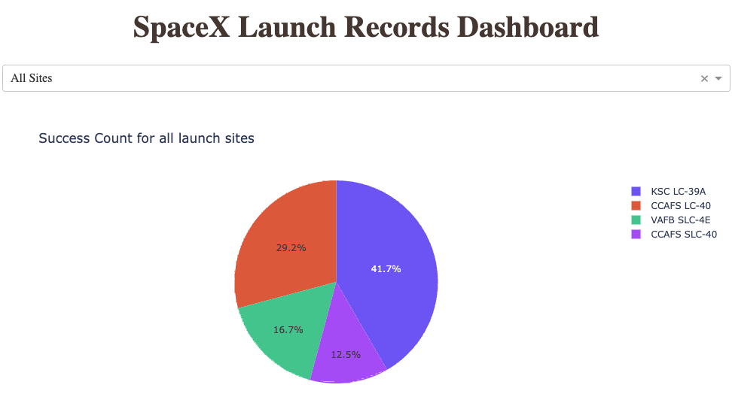
Pie chart showing the success percentage achieved by each launch site
Launch success count for all sites
KSC LC-39A had the most successful launches from all the sites

Slide 40
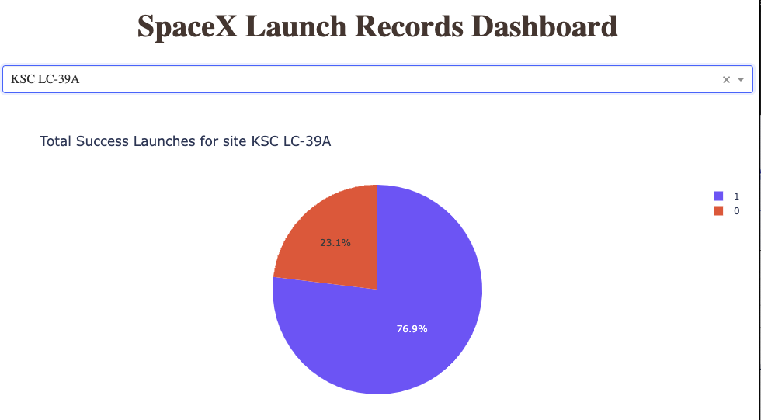
Pie chart showing the Launch site with the highest launch success ratio
The pie chart for the launch site with the highest launch success ratio
KSC LC-39A achieved a 76.9% success rate while getting a 23.1% failure rate

Slide 41
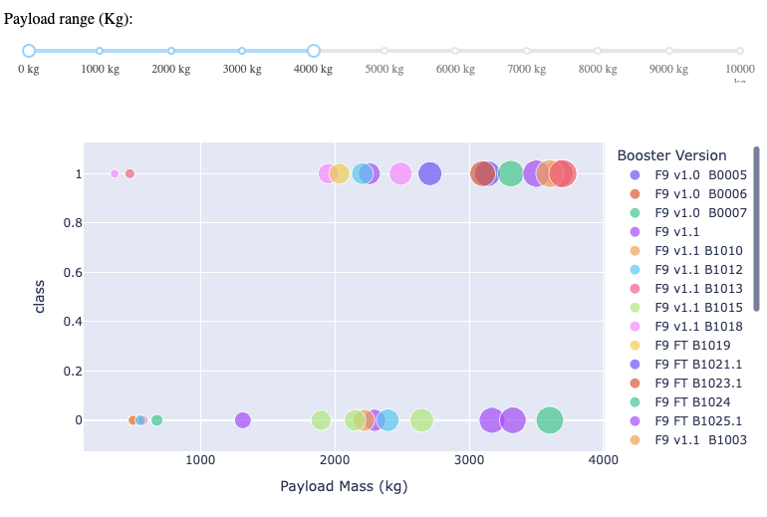
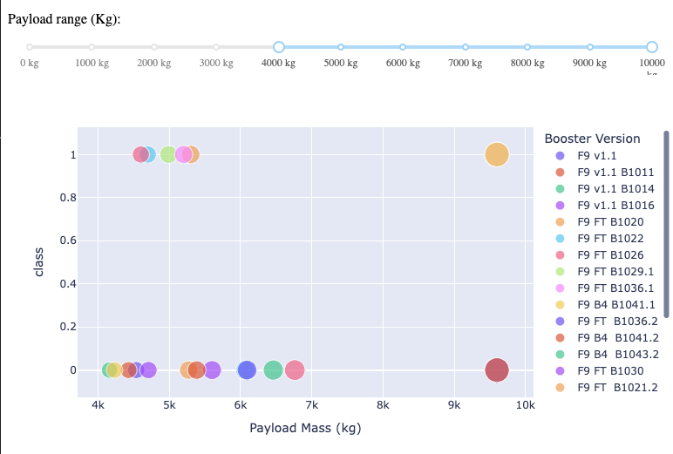
Scatter plot of Payload vs Launch Outcome for all sites,
Payload vs. Launch Outcome scatter plot for all sites, with different payload selected in the range slider
Low Weighted Payload 0 – 4000kg: Heavy Weighted Payload 4000 – 10000kg:
The Success rates for low weighted payloads is higher than the heavy weighted payloads

Slide 42

Section 5

Slide 43
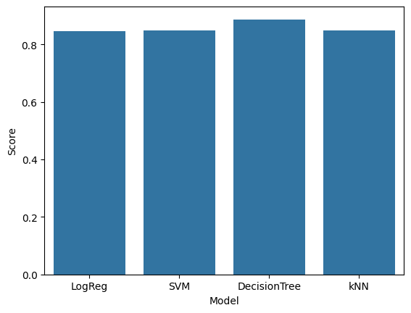
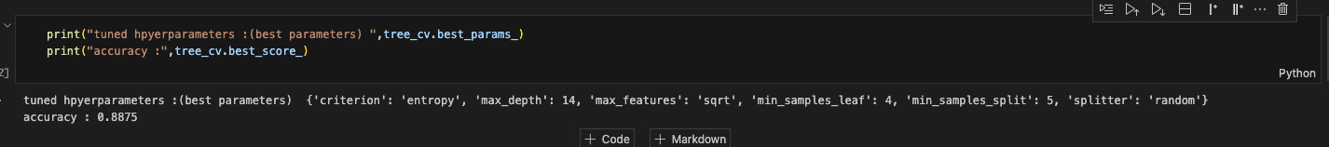
Classification Accuracy
Decision Tree model has the highest classification accuracy with 0.8875

Slide 44

Confusion Matrix
The classifier can distinguish between the different classes.
The major problem is the false positives .i.e., unsuccessful landing marked as successful landing by the classifier.

Slide 45
Conclusions
The larger the flight amount at a launch site, the greater the success rate at a launchsite.
Launch success rate started to increase in 2013 till 2020.
The most success rate was in Orbits ES-L1, GEO, HEO, SSO, VLEO.
KSC LC-39A had the most successful launches of any sites.
The Decision tree classifier is the best machine-learning model.

Slide 46


